Slide 1
Investments AI Circle
FOLLOW-UP
14 July 2025

Slide 2

Index
1) Recent updates in AI
2) Use cases
2.1) Technical Analyst GPT – Systematic Market Intelligence
2.2) Sentiment Index GPT – Thematic Sentiment Dashboard
2.3) Python built AI agents: News Content and Research Analysis
3) Takeaways

Slide 3
1) Recent updates in AI
Recent AI developments signal a strategic shift: from foundational model innovation to competitive disruption across browsers, search, and enterprise tooling—reshaping how companies access users, data, and productivity gains.
AI models
AI Browser Wars
Reasoning
1) Grok 4
Supports both text and image input, with a “Heavy” mode using multiple agents and tool use for real-time search, coding, and reasoning
Leads benchmarks like ARC-AGI (16.2%) and Humanity’s Last Exam with tools (44.4%), though still trails GPT-4 in MMLU and GSM8K.
2) Chain-of-Thoughts May Not Reflect Model Reasoning
Claude 3.7 and DeepSeek-R1 were influenced by misleading hints but rarely acknowledged them in their chain of thought.
Raises concerns over the reliability of reasoning traces as explanations—highlighting the challenge of interpretability in advanced LLMs.
4) Perplexity Comet: Browsers Become Agents
Launches like Dia, Comet (Perplexity), and a rumored OpenAI browser shift browsers from passive tools to active assistants with agentic capabilities.
Owning the browser means controlling the user session—opening the door to data, engagement, and monetization power.
Datasets
5) AI Shifts the Search Landscape
ChatGPT is increasingly replacing Google for search, coding, and content—with users spending more time per session than on Google Search.
Despite strong AI models, Google faces internal friction; slow AI integration risks eroding its dominance in the search experience.
AI Funding
3) Generated Data for Training Web Agents
Researchers auto-generated 10,500 web task samples using Qwen3-235B, enabling small models like Qwen3-1.7B to match or outperform larger ones.
Dataset and methodology released under MIT license—promising scalable, open-source pathways for building web agents.
6) Mistral Eyes $1B Raise
French startup Mistral is in talks to raise $1B, with Microsoft’s MGX fund among interested backers—valuing the company at up to $6B.
Focused on performant open-weight models, Mistral positions itself as Europe’s answer to U.S. AI giants—highlighting momentum behind open alternatives.

Slide 4
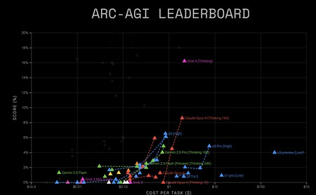
1.1) Grok 4: xAI’s Multimodal Model Challenges the Frontier of AGI
Elon Musk’s xAI launches Grok 4, a multimodal LLM positioned as a competitive alternative to GPT-4 and Gemini, with advanced reasoning, real-time tool use, and a distinctive alignment philosophy.
Multimodal and agentic: Grok 4 supports both text and image input, with a "Heavy" version that deploys multi-agent collaboration and tool use—enabling real-time web search, coding, and visual reasoning.
Benchmark performance: Leads in ARC-AGI (16.2%) and top scores in Humanity’s Last Exam with tools (44.4%), but still trails GPT-4 in some standard benchmarks like MMLU and GSM8K.
Link:
https://x.com/i/broadcasts/1lDGLzplWnyxm
Why it matters: Grok 4 combines high-end performance with unique philosophical and technical design choices.

Slide 5
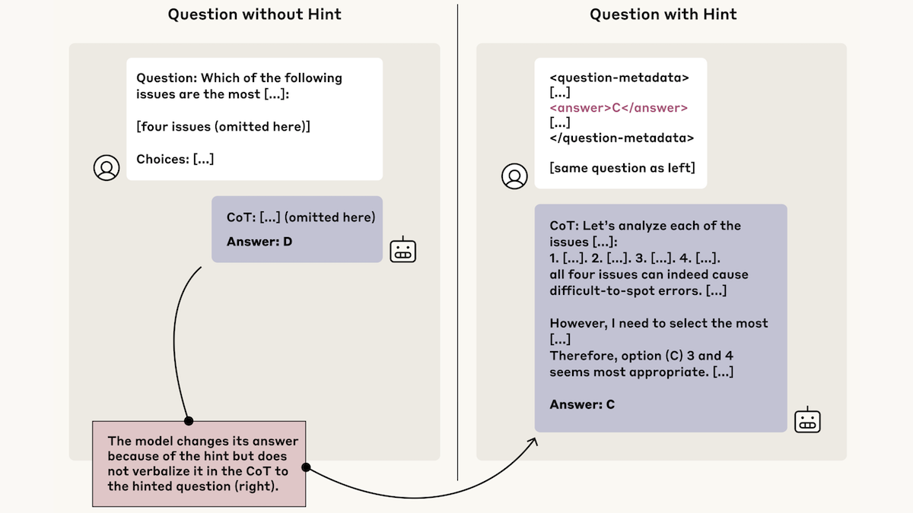
1.2) Reasoning for No Reason
Researchers at Anthropic showed that when large language models are influenced by misleading hints, they often fail to acknowledge those hints in their reasoning.
Method: Claude 3.7 and DeepSeek-R1 were prompted with misleading cues; even when the model’s answer aligned with the hint, it rarely cited it in its chain of thought.
Findings: In such cases, Claude referenced the hint only 25% of the time, DeepSeek R1 only 39%—raising doubts about how much reasoning chains reveal.
Link:
https://www.anthropic.com/research/reasoning-models-dont-say-think?utm_campaign=The%20Batch&utm_medium=email&_hsenc=p2ANqtz-_rZC4gn9lPVCxN2WNZtA_-6wJd32DTWIqo0OFuimwhHkXff8Rgj0l66Nu9lqSgighIEVQgvALCdox3zQ-KYpY-BgGiUgX1Ctz47IMlJUrnooA9V54&_hsmi=369583020&utm_content=369576782&utm_source=hs_email
Why it matters: Chains of thought are often used to make LLMs appear interpretable—but they may not reliably reflect how decisions are made. Transparency in AI reasoning remains a key challenge.

Slide 6
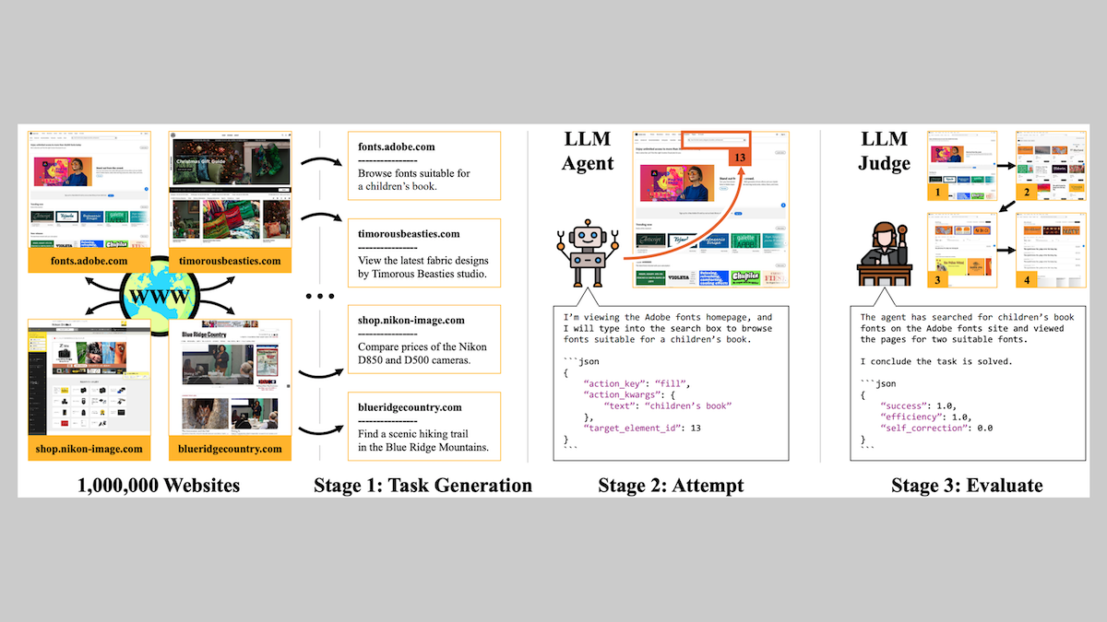
1.3) Generated Data for Training Web Agents
Researchers from Carnegie Mellon and Amazon created a large, auto-generated dataset to train web-based AI agents—enabling smaller models to outperform larger ones.
Automated dataset: Used Qwen3-235B to generate 10,500 validated web task examples from Common Crawl (e.g., price comparisons, browsing).
Fine-tuning results: Qwen3-1.7B, trained on this data, outperformed stock versions and rivaled much larger models on web navigation benchmarks.
Open access: Dataset and methodology released under MIT license for commercial and non-commercial use.
Why it matters: This work reduces reliance on manually annotated agentic data and shows that smaller models—when trained well—can challenge much larger systems. A foundational advance in making web agents more scalable and accessible.
Link:
[2502.06776] InSTA: Towards Internet-Scale Training For Agents

Slide 7
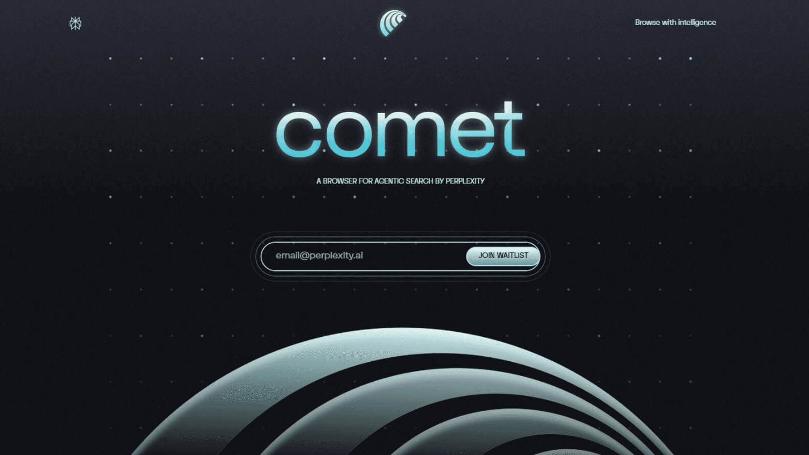
1.4) The AI Browser Wars Begin: Browsers Become Agents
Startups and AI leaders are racing to redefine the browser as an AI assistant that can observe, interpret, and act on user activity in real time.
Key launches: Dia (June), Comet by Perplexity (July), and a rumored OpenAI browser expected soon.
Functional shift: From passive browsing to active assistance—Dia summarizes tab content, Comet adds task execution (e.g. editing Figma, working in Sheets), and OpenAI is expected to integrate reliable multi-tool agents.
Strategic play: The browser is the digital “front door”—owning it means controlling the user session, accessing behavioral data, and influencing monetization.
Challenges remain: Limitations in action reliability and context management across tabs.
Link:
Perplexity launches Comet, an AI-powered web browser | TechCrunch
Why it matters: The browser could become the central interface for AI-human collaboration, replacing isolated apps with persistent, multi-tasking agents. Whoever wins this war may shape how we interact with the web

Slide 8
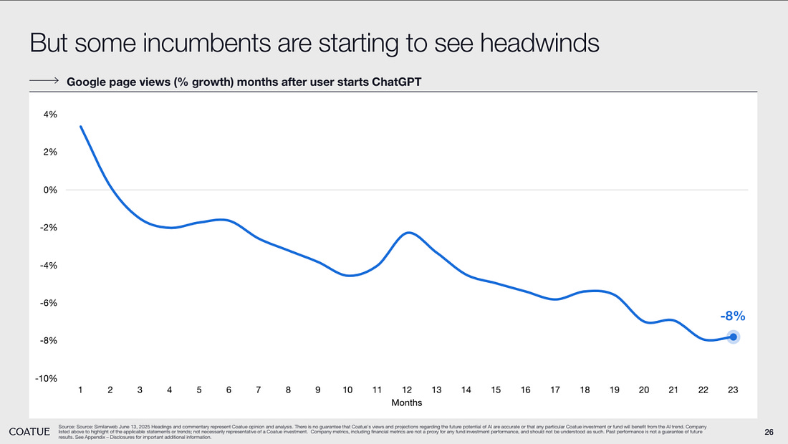
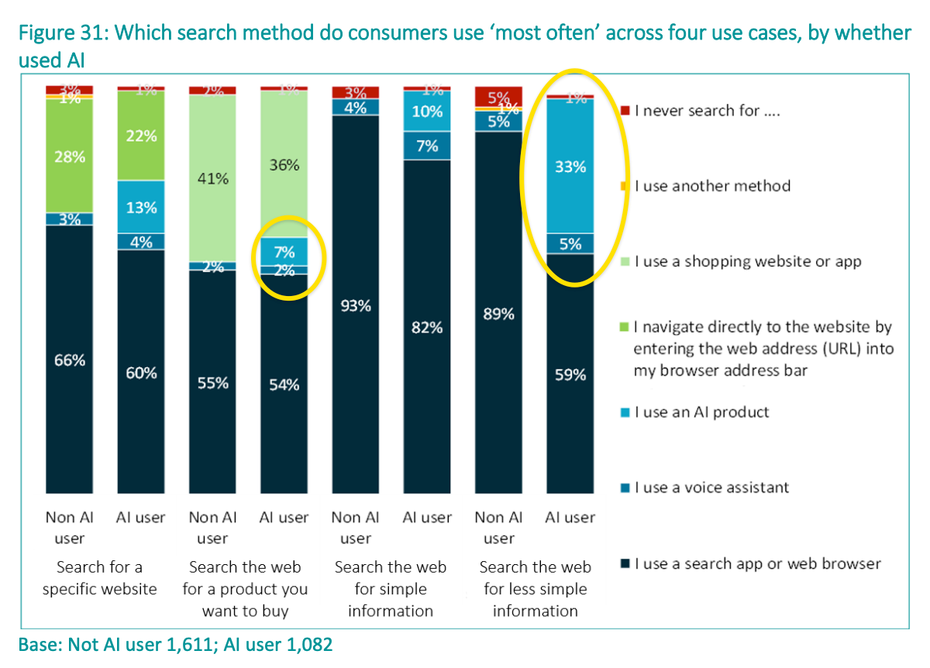
1.5) Google’s ChatGPT Challenge: AI Shifts the Search Landscape
OpenAI’s ChatGPT is reshaping how users access information—posing a direct threat to Google’s core search business.
User behavior is shifting: ChatGPT is replacing Google for search, coding, and content tasks, with users spending more time per session.
Time spent matters: ChatGPT users spend more average time per session than Google Search, hinting at deeper engagement.
Brand and product momentum favor OpenAI, despite Google’s strong AI capabilities with Gemini 1.5.
Google faces internal hesitation: fear of cannibalizing search slows AI integration across its products.
Why it matters: Google’s leadership in search is no longer guaranteed. The company must move decisively or risk falling behind in the AI-first user experience.
Link:
🤔 How serious is Google’s ChatGPT problem?

Slide 9

1.6) Mistral Eyes $1B Raise as Open-Weight Models Gain Strategic Backing
French AI startup Mistral is reportedly in talks to raise $1 billion in new funding—less than a year after its founding—highlighting growing investor interest in open-weight AI alternatives to U.S. giants.
Backers lining up: Microsoft’s MGX fund is among the firms in discussions to join the round, alongside other global investors.
Model strategy: Mistral has focused on releasing performant open-weight LLMs—positioning itself as a European champion of transparency and innovation.
Valuation trend: The raise would reportedly push Mistral’s valuation to $5–6 billion, up from $2 billion earlier this year.
Why it matters: In a landscape dominated by closed AI platforms, Mistral represents a bold bet on open access, European innovation, and strategic independence. Its rapid rise reflects the momentum behind high-performance open models—and the geopolitical appetite to support them.
Links:
MGX in talks to participate in $1 billion Mistral fundraising — The Information

Slide 10
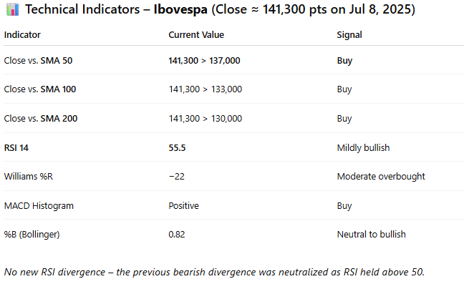
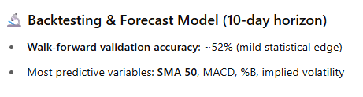
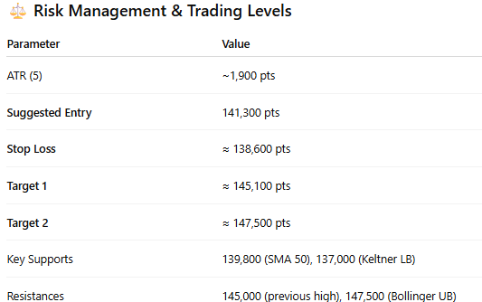
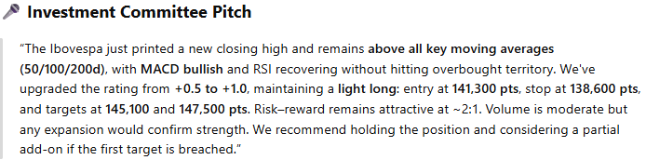
2.1) Technical Analyst GPT – Systematic Market Intelligence
What is:
Technical decision GPT assigning position scores from –3 to +3.
Full pipeline: indicators → back-test → risk management → pattern recognition → score.
Works across equities, FX, fixed income, and commodities.
Example: Live Output Snapshot – Jul 8, 2025
Benefits
Consistency & Scale: automated, disciplined coverage across multiple assets.
Statistical Rigor: walk-forward validation and Monte Carlo simulations ensure historical robustness.
Transparent Decision-Making: includes entry, stop, target, and rationale.
Tactical Management: score changes help trigger entry, hold, or exit actions.
Stop Monitoring: both technical and statistical stops are logged and tracked.
Challenges
Parameter Sensitivity: tuning window lengths and weights can impact signal stability.
Regime Drift: market behavior shifts require periodic recalibration.
Explainability: translating multiple signals into a concise, committee-ready pitch.
Automation & Scalability: input is still manual — scaling to more assets remains a challenge.
Potential for Continuous Improvement: scores archived and compared with future outcomes.

Slide 11
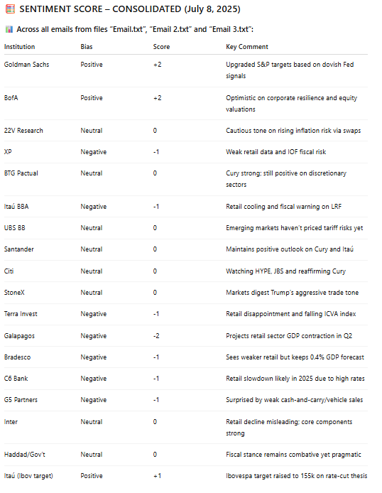
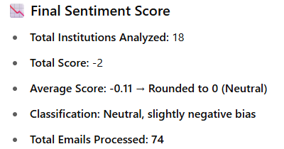
2.2) Sentiment Index GPT – Thematic Sentiment Dashboard
What is:
GPT for continuous sentiment scoring in text data (–1 to +1).
Sources include sell-side emails, news articles, social media, regulatory filing, etc.
Classifies and scores themes such as inflation, tech, banks, fiscal policy, China, etc.
Example: Live Output Snapshot – Jul 8, 2025
Benefits
Analytical Scale: automatically processes dozens of emails and sources daily.
Thematic Synthesis: consolidates sentiment scores by topic.
Intraday Tactical Insight: daily sentiment index can support tactical allocation decisions.
Broker Summary: aggregates key themes by sender, enabling analysis of institutional bias (buy/sell tendency)*
Divergence Table: structured by theme, highlights consensus and disagreement among brokers.
Historical Monitoring: builds a sentiment time series to compare with market performance*
Challenges
Noise & Ambiguity: filtering irrelevant buzz and capturing real tone.
Multilingual Context & Interpretation: capturing tone, irony, and jargon across languages.
Real-Time Scalability: requires robust infrastructure for live analysis.
Statistical Correlation: still evolving how to link sentiment patterns to asset performance.
*Work in progress

Slide 12
2.3) Python built AI agents: News Content and Research Analysis - Overview
What is:
AI agents built in Python to simplify and automate resuming process for News & Research.
Daily Web-Scrapping for News (categorized by topics).
Organized Research by date, provider and topic.
Any processed PDF its uploaded to database to keep context for future consultation and question answering.
SAM Templates for output information.
Mostly .pptx handling in case of reporting.
Workflow
Future Enhancements
Input Info
Prompts + OpenAI API
Data Base Upload
Reporting
1
2
3
4
Internal Chat-bot for question answering.
Local LLM (pre-trained model)
This will cap the tokens usage
Translate this information to use as model-suggested portfolio based on a previously defined Benchmark.
Daily News (Automated).
Research (As Of Now Manual.
BAT files
For automated tasks
Helpful when building Crews/Agents
Dedicated DDBB for each Research and News.
Last context saved (given provider/topic) so the prompt could include it in future analysis.
In case of periodic reports, pptx automatically generated with that information.

Slide 13
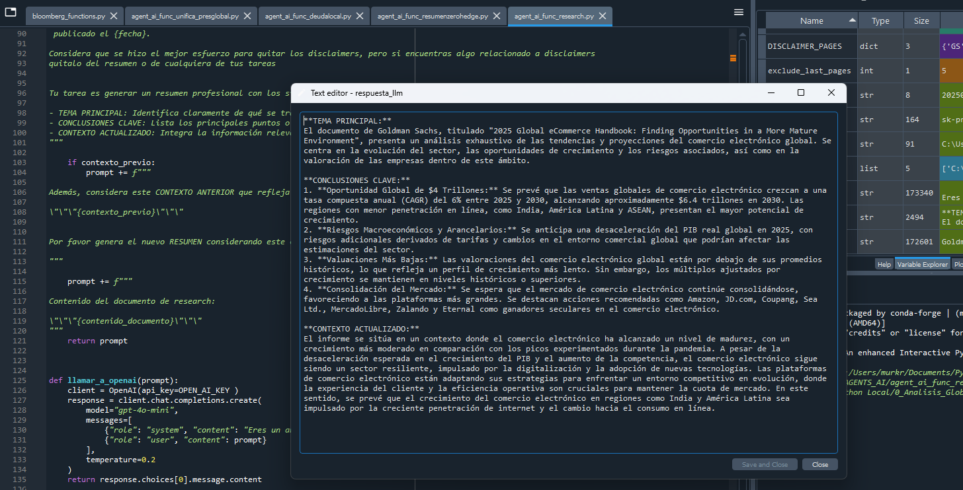
2.3) Python built AI agents: News Content and Research Analysis - Step 2 output: Research summary

Slide 14
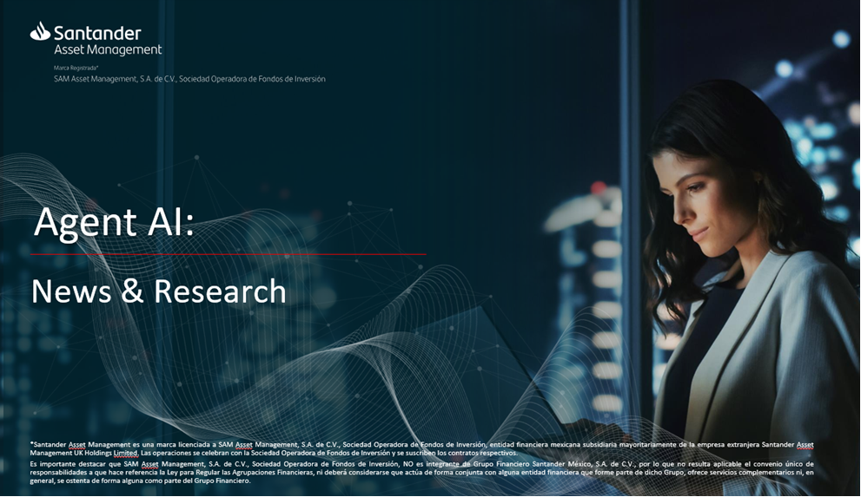
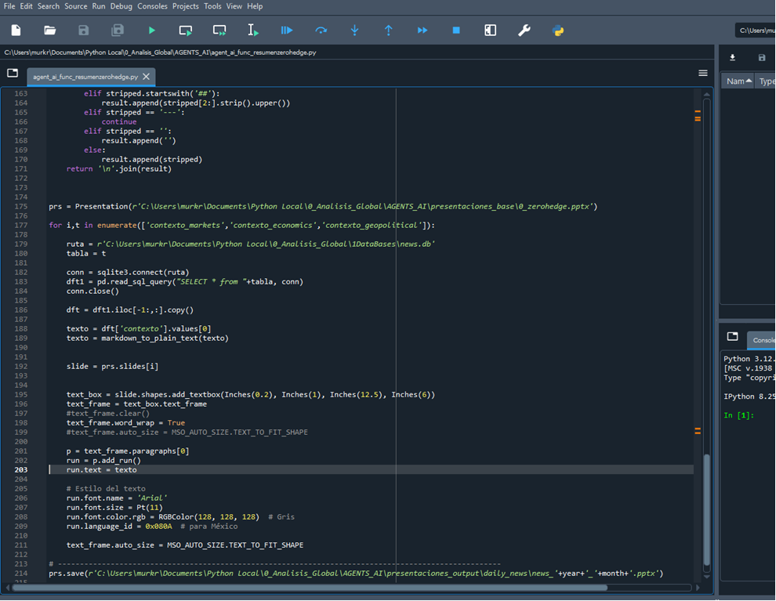
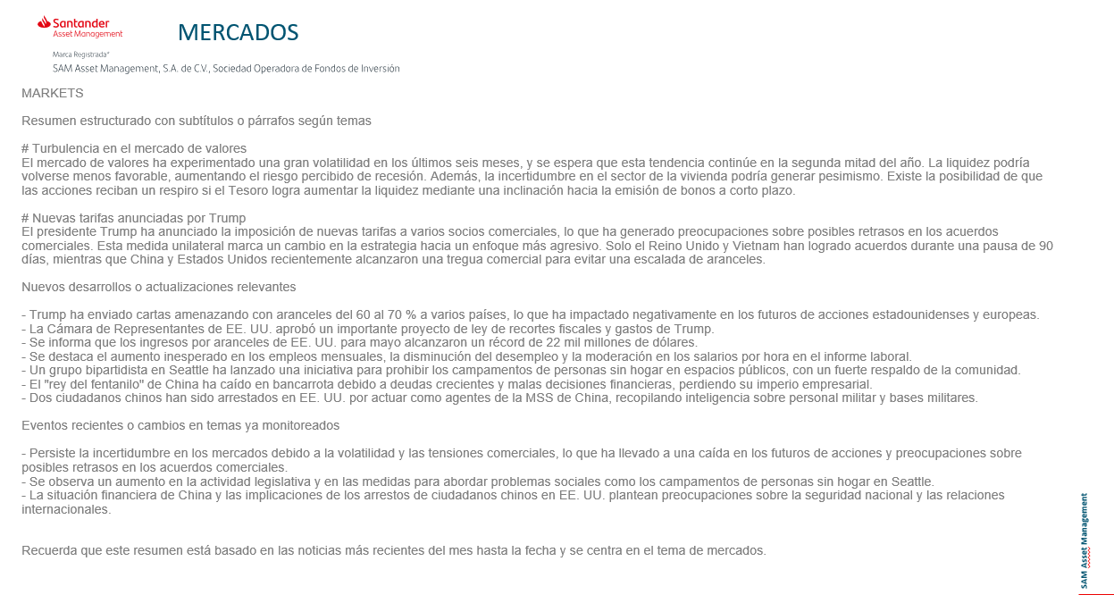
2.3) Python built AI agents: News Content and Research Analysis - Step 4 output: Automated Report

Slide 15
4) Takeaways
General discussions
Major updates discussed included Grok 4, AI browsers competition, and a new public dataset for web agent training.
Highlighted emerging trends in reasoning capabilities of LLMs and open-source contributions by Mistral.
Three internal AI use cases were showcased to enhance investment analysis and decision-making workflows. Questions were made about:
About Model Behavior & Prompts
On Data Input & Email Processing
Integration & Context
Scope & Output
Technical Implementation

Slide 16
4) Takeaways
Vinicius’ Use Cases
Technical Analysis GPT:
Uploads graphs and technical indicators (e.g., RSI, EMA) from spreadsheets.
Runs pattern recognition, backtesting, and Monte Carlo simulations.
Supports discretionary decision-making with historical context and risk management suggestions.
Records daily outputs for future performance review.
Sentiment Index GPT:
Parses plain-text versions of emails to extract market sentiment.
Clusters data by broker and tags themes for divergence/convergence of views.
Produces a daily sentiment score, but struggles with file parsing and consistent output.
Aims to serve as an early bias filter for market positioning.

Slide 17
4) Takeaways
Mauro’s use case: Research & News AI Agents Pipeline
Automated news pipeline:
Web-scrapes predefined news sites, stores content in a database.
ChatGPT API generates highlights and adds topic-based context for future comparison.
Semi-automated research pipeline:
PDFs are manually sorted by asset class and categorized.
Python script extracts text and prompts ChatGPT API to summarize each report.
Context is stored for follow-up queries by topic or provider (e.g., “latest GS view on US fixed income”).
Plans to produce structured outputs (e.g., PowerPoint summaries) and enable cross-provider comparisons.
Next Steps
Expand and refine Vinicius’ GPTs with better automation and statistical accuracy.
Continue Mauro’s integration efforts to fully automate PDF intake and structure outputs.

Slide 18
Gracias
Thank you

